Slide 1


AI-Powered WhatsApp Business Assistant
Empowering Indian SMEs with intelligent customer interaction.

Slide 2

THE CHALLENGE
The Communication Gap for Indian SMEs
In India, many small businesses, from local kirana stores to coaching centers and clinics, rely heavily on WhatsApp for daily customer communication. It's their primary interface with clients.
However, limited manpower and technical expertise often hinder their ability to respond promptly to queries, manage orders efficiently, and maintain organized business records.

Slide 3
PROBLEM ANALYSIS
Limitations of Existing Solutions
Language Barriers
Affordability & Usability
Operational Inefficiency
Most current automation and CRM platforms are primarily designed for English speakers, lacking effective support for diverse Indian regional languages.
Small businesses often lack access to affordable, user-friendly tools that can automate customer interactions and order management through familiar platforms like WhatsApp.
The combination of these factors leads to lost potential customers and significant operational inefficiencies for SMEs.

Slide 4


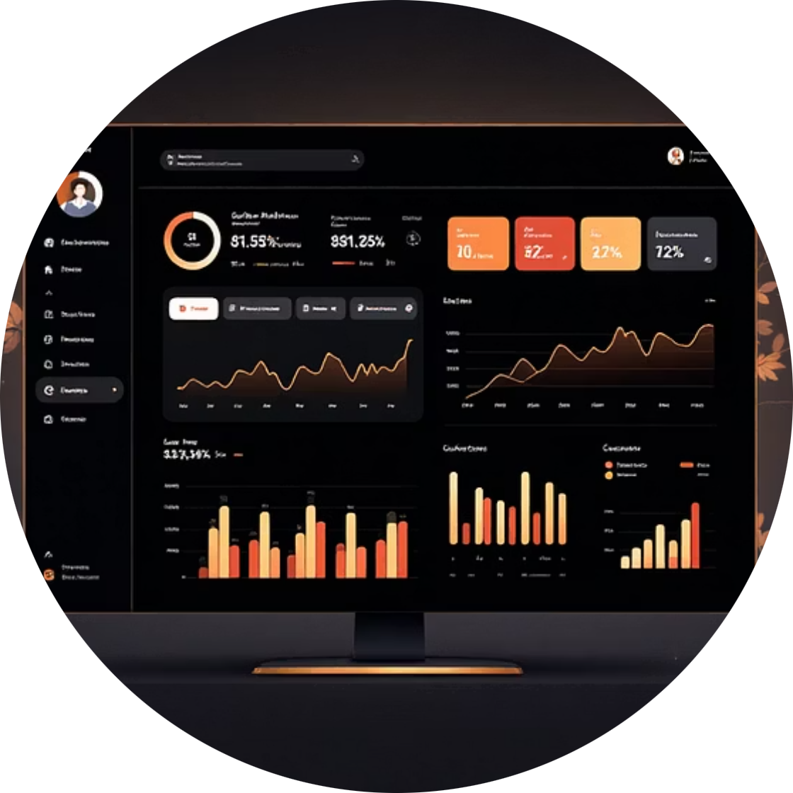
OUR SOLUTION
Introducing the WhatsApp Business Assistant
An AI-powered system designed to transform how Indian SMEs engage with their customers on WhatsApp.
Multilingual Support
Order & Payment Management
Web-Based Dashboard
Understand and respond in Hindi, Urdu, and English, bridging communication gaps.
Automate order taking, management, and secure payment link generation.
A central hub for tracking sales, orders, and all customer interactions.

Slide 5

EXAMPLE USE CASE
VyaparAI in Action: Rajesh Kirana Store
Let's illustrate how VyaparAI transforms customer interactions for a typical Indian small business, Rajesh Kirana Store in Hyderabad.
01
02
Seamless Onboarding
Multilingual Customer Order
Rajesh registers, adds products like "Aata ₹48/kg" and "Rice ₹60/kg", and selects Urdu and Hindi for communication.
A customer messages in Urdu: "ایک جآ 3 کلو چاول مل یئاج ؟ ے گ" (Can I get 3kg rice today?)
03
04
Intelligent AI Response
Real-time Dashboard & Updates
VyaparAI detects Urdu, processes the order, confirms availability, and replies in Urdu with details and a Razorpay payment link.
Rajesh views the paid order on his dashboard. Once dispatched, the customer receives an automated delivery update.
05
Smart Analytics & Marketing
The dashboard provides daily insights (e.g., peak times, top products). Rajesh can then use AI to generate and send targeted offers to customers.

Slide 6

PROJECT GOALS
Key Objectives for Development
Multilingual Chatbot
Analytical Insights
Web Dashboard
ML Models
Our objectives are clear: to build a comprehensive, intelligent, and user-friendly solution that significantly enhances SME operations.

Slide 7
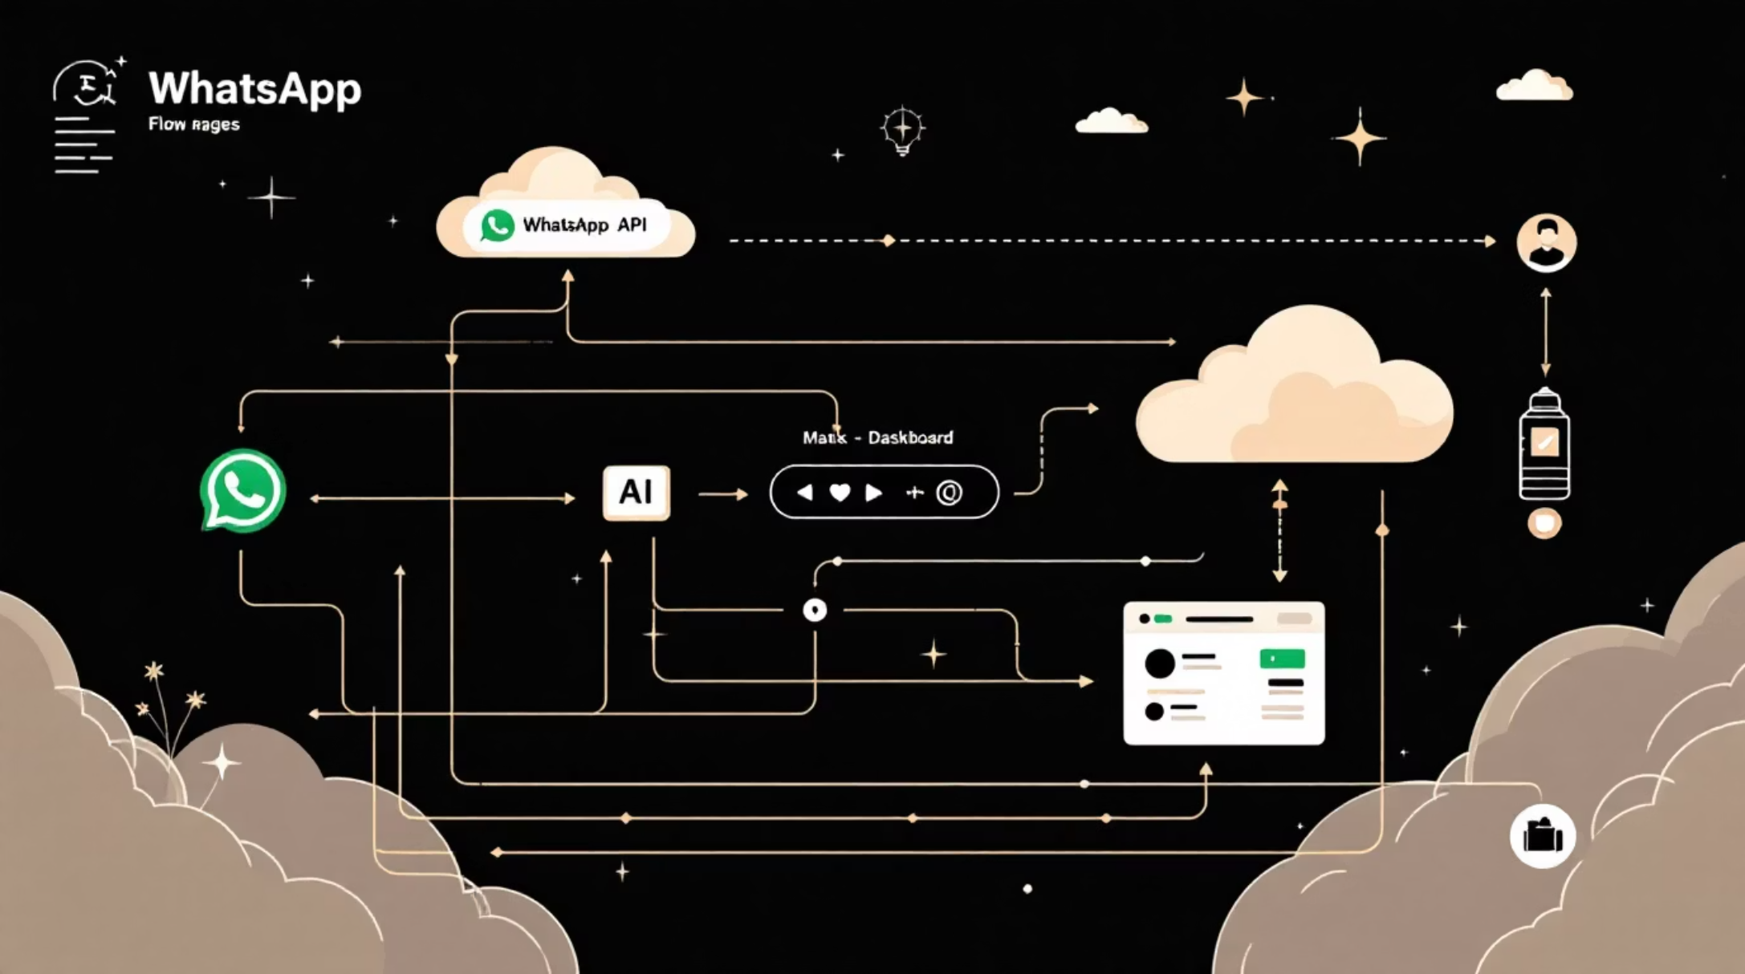
TECHNICAL ARCHITECTURE
How the System Works
The system operates on a robust client-server architecture.
WhatsApp messages are received via the WhatsApp Cloud API.
Messages are forwarded to a backend server for processing.
AI models perform language detection and intent classification.
Appropriate responses are generated and sent back to the customer.
All transactions and message logs are stored in a database and displayed on the web dashboard.

Slide 8






TECH STACK
Tools and Technologies
Frontend
Backend
Database
AI/ML
React / Next.js
Node.js / Express / FastAPI
Supabase / Firebase
Python, Scikit-learn, Transformers
APIs
Deployment
WhatsApp Business Cloud API, Razorpay
Cloud Hosting (Railway / Render / VPS)

Slide 9


IMPACT
Expected Outcomes
100%
User-friendly
Improved
Functional AI WhatsApp Assistant
Business Management Dashboard
Customer Response Time & Digital Adoption
This project aims to deliver tangible benefits, enhancing efficiency and digital presence for Indian SMEs.

Slide 10
GROWTH POTENTIAL
Future Scope and Enhancements
01
02
Voice-Based Interaction
Mobile App for Owners
Integrate voice capabilities for a more natural customer experience.
Develop a dedicated mobile application for business owners to manage operations on the go.
03
04
GST Invoice Generation
Advanced Forecasting
Automate the creation of Goods and Services Tax (GST) compliant invoices.
Implement sophisticated models for sales prediction and inventory forecasting.

